Slide 1
Native Apps & Appium

Slide 2
Agenda
Capabilities for Working with Apps
Application Types
The Appium Driver – template & options
Interacting with Apps – contexts
Notes:
We focused on web applications so far. In this module we will look at native & hybrid applications.
Everything we have learned in web is valid with native apps, we just need to select the correct driver & context & then continue to use the same commands as before.

Slide 3
Capabilities for Native & Hybrid Apps

Slide 4
Applications and Appium
Appium extends Selenium to support mobile application automation.
Relevant for Native or Hybrid applications
Use capabilities to identify and launch the application.
Alternative to launch the application from the test code, with driver.launchApp() method.
Perfecto extends Appium with additional Capabilities
Install the application from the Repository.
Perform application instrumentation (see separate slide).
Setup the application environment – reset to scratch, retain previous data, etc.

Slide 5
Identifying the Application
Mobile applications all define a unique identifier. Appium uses this identifier to target the right application.
Android applications
“appPackage” provide the packageID of the app.
“appActivity” provide the Activity (specific application screen) that should be started for the application (optional)
iOS applications
“bundleID” provide the bundleID of the app.
capabilities.SetCapability("appPackage", "com.google.android.keep");
capabilities.SetCapability("appActivity", ".activities.BrowseActivity");
capabilities.SetCapability("bundleID", "com.yoctoville.errands");

Slide 6
Installation and Instrumentation
Use “app” capability to specify location of application file in Repository.
“PUBLIC:<folder>/<file>” for files in the Public Media folder
“PRIVATE:<folder>/<file>” for files in the My Media folder
Use “autoLaunch” capability to control if Appium automatically installs and launches the app.
As part of the installation, Perfecto can instrument the application –
Pre-process the application to allow Perfecto features to interact with the application.
Web-view instrumentation – for Hybrid applications, allows Perfecto to automate the HTML parts of the application.
Sensor instrumentation – allows Perfecto to interact with camera, fingerprint reader, and other device sensors.
Use “autoInstrument” or “sensorInstrument” capability to specify to Appium driver to perform the required instrumentation on the application.
Notes:
Open the webpage and review the different options available.

Slide 7
Launching & Resetting Apps
Perfecto’s Appium extensions provide several options regarding resetting apps and deleting application data.
Resetting the app - “noReset” & “fullReset“ capabilities
“fullReset” uninstalls the app if it is on the device, reinstalls the app & then uninstalls at the end of the execution.
“noReset” disables the reset functionality.
Default behavior is false, i.e. these capabilities are not used.
Warning: Uninstalling & installing the app upon execution may take extended time.
The “dataReset” capability allows retaining app data when installing a new version.
Allows the test to use data generated during a previous run.

Slide 8
What is the correct configuration?
To decide the correct configuration for your organization, consider the following criteria:
Tests must run on latest version?
Does the test require app to open with no data or with it’s history (username etc.)?
In most cases the requirement is to always run the latest version and the data varies per type of test.
Perfecto supports CI connection (for example, integrated with a tool like Jenkins) where tests are run automatically.
In a CI context, we recommend installing the latest app version, with instrumentation (if needed), at the beginning of the cycle.
Individual tests can overwrite the general setting if the test requires it.
Notes:
We will revisit this issue in the CI connection module.

Slide 9
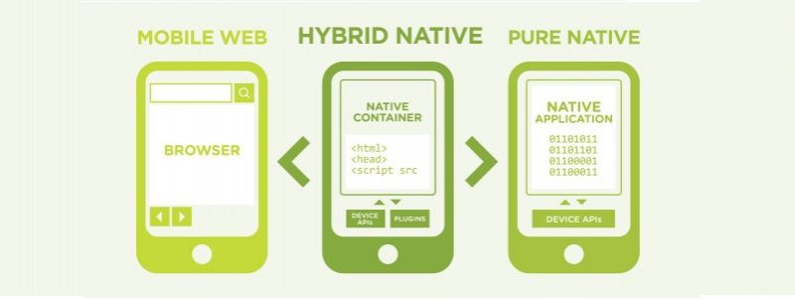
Application Types

Slide 10
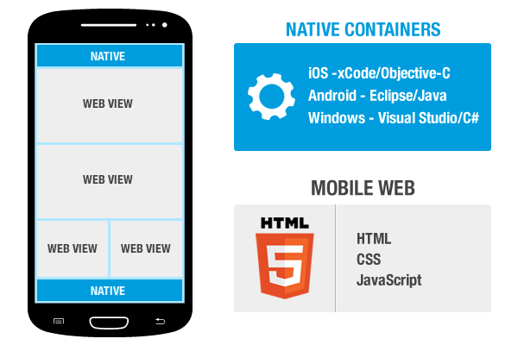
Hybrid Applications
Hybrid Applications are composed of a Web portion shared across platforms and a Native part unique to the OS
Each part of the application requires its own context.
Learn the application you are working on to see what type it is and which elements are Web View and which are Native.
Notes:
This sounds complicated but remember that it is static. In most hybrid apps the web/Native parts are clearly differentiated e.g the menu will be Native and the content Web.

Slide 11
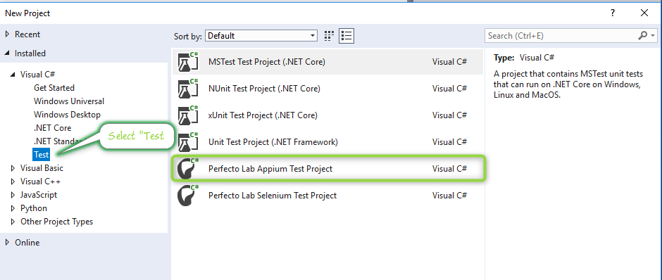
The Appium Driver
Working with Native Apps is very similar to websites
Native Apps should be automated with an Appium driver
The OS specific driver is selected within the project code.
When working with a framework, it should select the correct driver automatically.
Notes:
Native Apps require the Appium Driver. Launching it is easy, select the C# Appium project type and then the correct driver.

Slide 12
The Appium Driver continued.
There is a different driver per platform, both are available in the template
Uncomment & use the one you require for the test.
//private AndroidDriver<IWebElement> driver;
private IOSDriver<IWebElement> driver;
ooo
var url = new Uri(
string.Format("http://{0}/nexperience/perfectomobile/wd/hub", host));
//driver = new AndroidDriver<IWebElement>(url, capabilities);
driver = new IOSDriver<IWebElement>(url, capabilities);
Notes:
Automatic driver selection is available in Perfecto’s Quantum framework. If you are going to use it then this will be happening automatically for you. If you are planning to use another FW we recommend adding this functionality to it and can assist in doing it.

Slide 13
Interacting with Apps – Contexts
We have used Contexts to switch between Objects & Visual methods.
The NATIVE_APP context is the default when using an Appium Driver.
Switching contexts will be needed when:
The Native App opens a Web browser
Hybrid App contains both Web & Native Elements
Visual Analysis is used.
Switch context using the Context member of the driver instance:
driver.Context = “WEBVIEW”;
driver.Context = “NATIVE_APP”;
driver.Context = “VISUAL”;

Slide 14
Thank You

